Slide 1
Let's talk Research
Come in quietly & have a seat at
a table. Be sure you can see the board.

Slide 2
How do I Research?
What is the assignment?
What are the best possible resources?
Where will I find this information?
*How will I record this information?
*How do I put it together?
What have I learned?

Slide 3
Basically... What is Research?
Asking Questions
Reading to Find Answers
Taking Notes
Presenting it

Slide 4
What is the assignment?
What is the problem I need to solve?
What is the question I want to ask?
What information do I need? Facts, opinions, pictures, graphs, etc.
When is it due?
Is there a checklist I need to follow?

Slide 5
Finding a topic
How do you find a topic? Think about something you are interested in. Think about something that you’ve heard a lot about recently.
Ask yourself:
What do you know about it? Where can you go to find out more? How do you learn about it?

Slide 6
Finding Questions
& answers
How do you come up with questions? Start by reading about topic. Think about what you want to learn and what you already know.
Where do you find the answers? Books Databases - Research Resources Encyclopedias

Slide 7
brainstorming
about topic
Key words… (List 10 words that relate to your topic)
Ex: Magnets
_____________ ____________
______________ ____________
______________ ____________
______________ ____________
______________ ____________
______________ ____________

Slide 8
How do I come up with Questions
about topic?
What is it..?
Where does it come from?
Why is it important…?
What are some of the uses…?
Why?

Slide 9
Where do I go to find it?
Encyclopedia & books
Databases – (PETROLEUM) Kids InfoBits – 155 articles World Book – 489 articles
Wikipedia ?
Google? – 53,300,000 websites Why not?

Slide 10
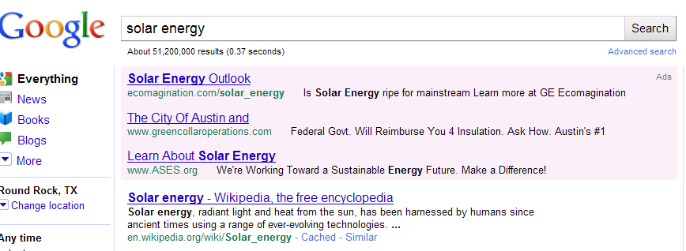
Why not Google or wikipedia?
Viruses
Inaccurate information
Too much information
Unreliable information
Unsafe

Slide 11
How do I Record Information
Organize when taking notes:
1. Data chart
2. Note cards
3. Notebook Paper
4. Graphic Organizer

Slide 12
How do I Record Information
Making a Data Chart
My Questions | Source | Where I looked for Information | Answers
 | World Book
When you have decided how to record the information you gather, write it down on your graphic organizer.

Slide 13
How do I Record Information
Making notecards
Question?
Answers:
Source:

Slide 14
7 minute Research
Pick a question to answer
Choose a small section of text to read
Read for 3 minutes without writing
Turn books/paper over so you can’t read any more
Write facts for 2 minutes that were interesting & that answered your questions

Slide 15
Practice Taking Notes
7 minute Research
What happened to the Belle?
Read the article but do not pick up a pen or pencil.
Look for the answer to this question while you are reading.
If you finish reading before 2 minutes, reread!
"solar energy." Britannica Elementary Encyclopedia. Encyclopædia Britannica Online School Edition.
Encyclopædia Britannica, Inc., 2012. Web. 19 Oct. 2012.
<http://school.eb.com/elementary/article?articleId=433607>.

Slide 16
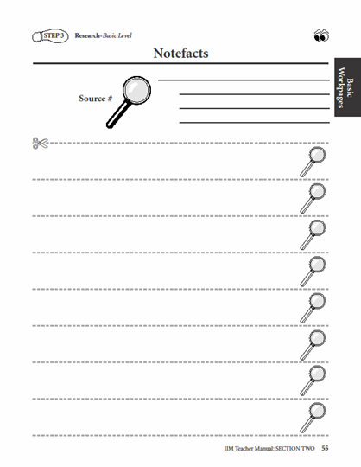
Now write your answers without looking back at what you read.
What happened to the Belle?

Slide 17
7 minute research
Continued
Look back at the text and check back for any information you might have missed, as well as for proper spelling, titles, specific headings, etc.
2 minutes

Slide 18
7 minute research
Continued
2 minutes - write more information that you missed on the back of your paper
3 minutes – read over the facts; which ones answer the questions or what new questions have you answered
Highlight facts that are important;
X out extra facts

Slide 19
Finding information/facts
Continued 7 minute research
Scan title, pictures, caption, graphics & headings
Write down where you found the information - bibliography
Author
Title of Book/Encyclopedia
Copyright ©
Page numbers

