Slide 1
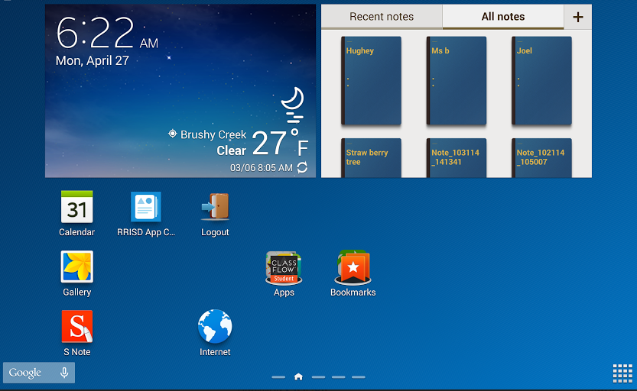
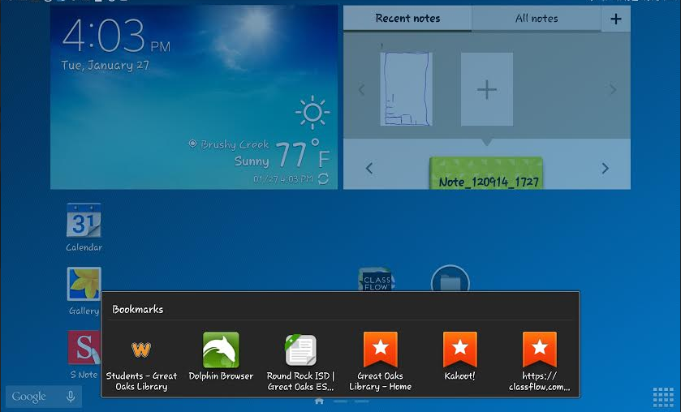
PIN:
0000
OK
1.
2.

Slide 2
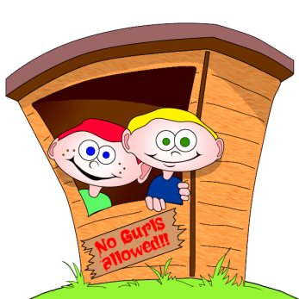
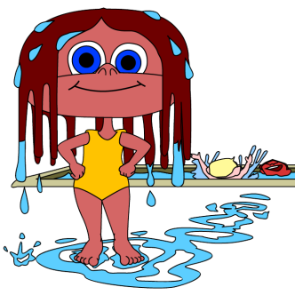
YOur turn to share
My name is... and one thing I like about summer is...

Slide 3
Welcome to the library
Pic Collage Today!
Come in quietly.
Have a seat at a table.
4 to a table.
Pic Collage

Slide 4
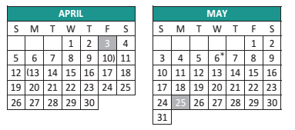

Slide 5
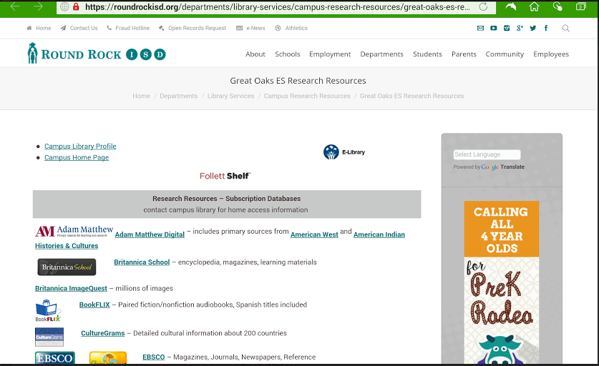
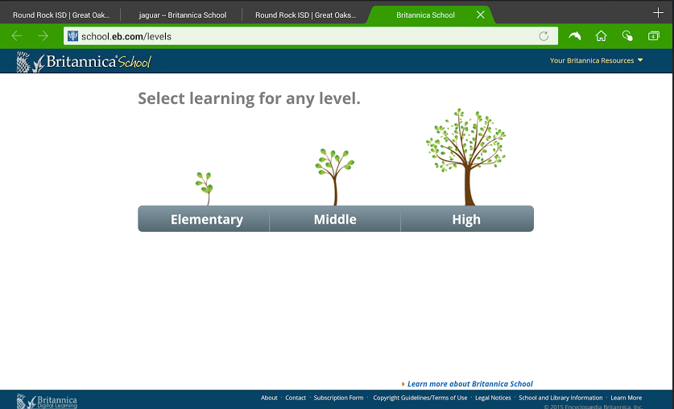
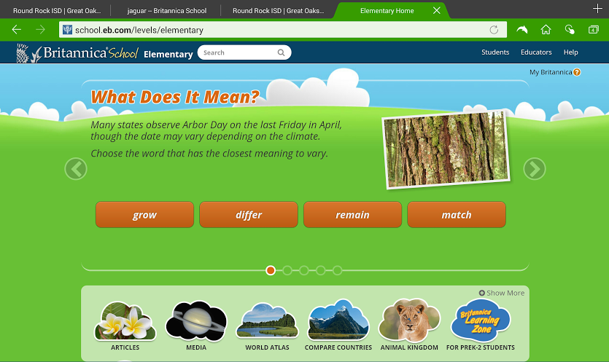
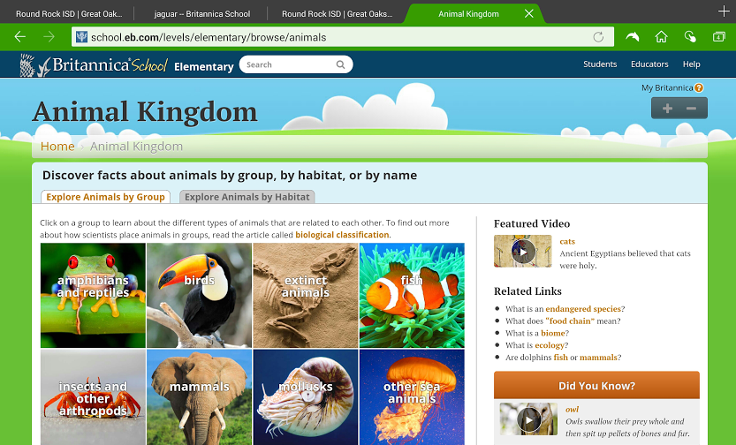

Slide 6
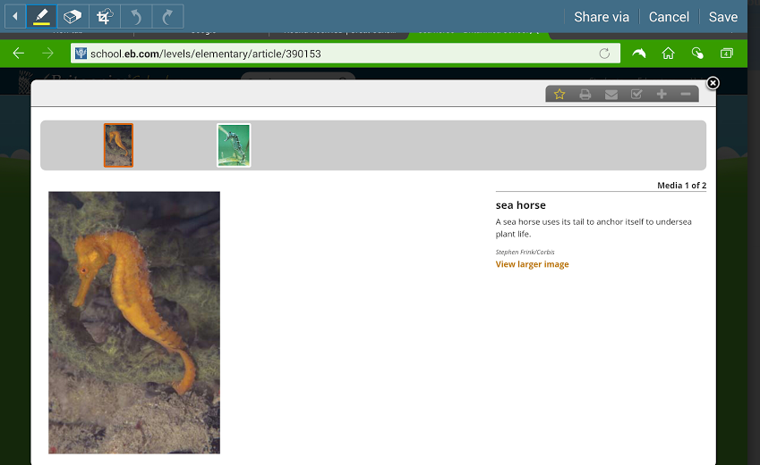
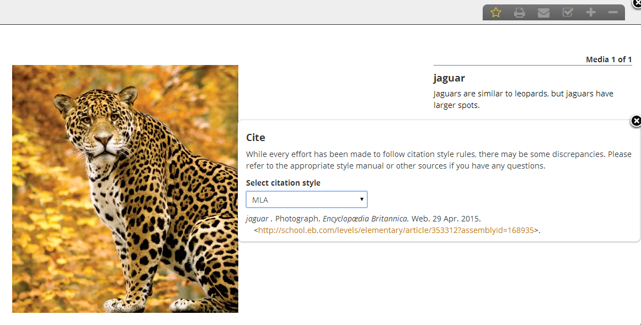
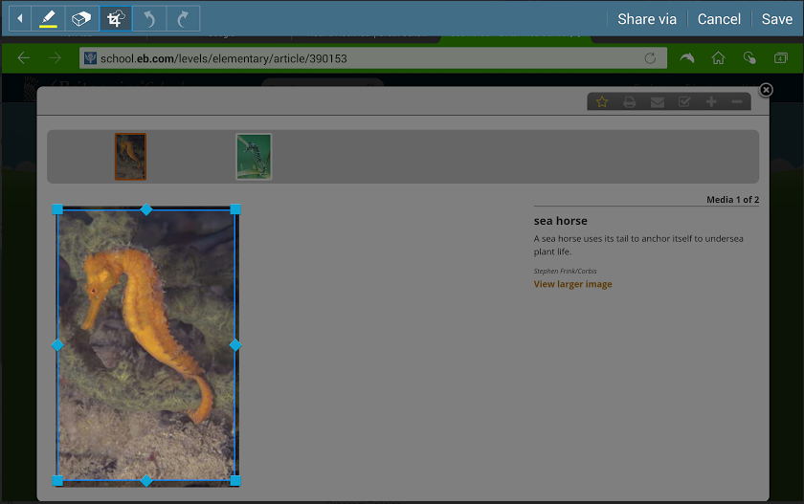

Slide 7
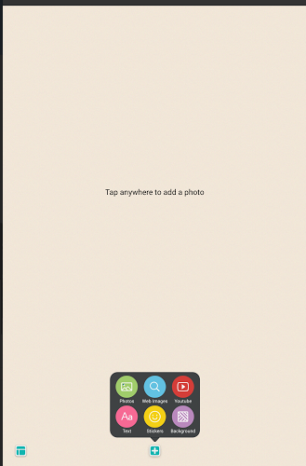
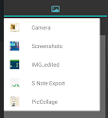
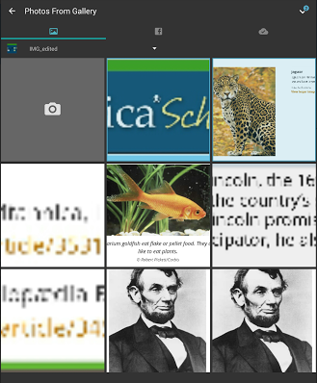

Slide 9
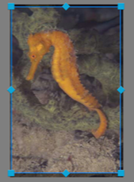
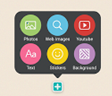
Directions
Go to Britannica School - find image of animal
Click on stylus button
Screenwrite
Crop image
Save
Screenwrite/crop/save citation
Screenwrite/crop/save Britannica School
Open Pic Collage
Insert Photos/IMG_EDITED
Type Name
Change Background

Slide 10
Log out & close windows...

